Slide 1
Axonal propagation BT6270 Introduction to Computational Neuroscience

Slide 2
The Hodgkin-Huxley model is an isopotential model.
It does not include “space.” It describes voltage change at a given point. Such models are called “point neuron” models.
It applies to a patch of membrane with homogenous distribution of ion channels and a uniform membrane voltage. Therefore, it does not describe signal propagation.
With a slight modification, the Hodgkin-Huxley model can be transformed into a model of voltage wave propagation in an axon.

Slide 3
The relationship between the membrane current, I_{m}, and second spatial derivative of membrane voltage.
This relationship can be used to develop a model of action potential propagation in the axon.
I_{ext} in the above equation represents I_{m} in eqn. (1) expressed per unit length.
(1)
(quantities defined per unit length)
(2)
(quantities defined per unit area)

Slide 4
The relationship between the membrane current, I_{m}, and second spatial derivative of membrane voltage.
This relationship can be used to develop a model of action potential propagation in the axon.
I_{ext} in the above equation represents I_{m} in eqn. (1) expressed per unit length.
(1)
(quantities defined per unit length)
(2)
(quantities defined per unit area)

Slide 5
To describe propagation along a cable, we need to express all membrane currents as per unit length.
For a cable of diameter, d, the membrane current per unit area of the axon is expressed by dividing the currents in eqn. (1) by π*d,
or

Slide 6
Im is the current passing through
the entire cylindrical strip of dia, d and
Width 1
Dimensions = amperes/length
Im/πd is the current passing through
this patch of dimensions 1 X 1
Dimensions = amperes/area

Slide 7
Now,
(3)
(4)
We need to seek propagating wave solutions for the above equation. Assuming the existence of a voltage wave, V(x – u_{t}), propagating with a uniform velocity, u, along the axon, the wave must also satisfy the wave equation,
(5)
Substituting (5) in (4)

Slide 8
Where I_{ionic} is the sum of all the ionic currents in eqn. (3) or eqn. (4) and,
Note that the currents are expressed in terms of per unit area, therefore they are independent of the axon diameter, d.
Similarly the voltage V_{m} must also be independent of d.
Therefore K must also be independent of d.

Slide 9
Since R_{i} and C_{m} are independent of d by definition, it implies that u²/d is independent of d. In other words,
(5)
Thus we have a relationship between cable diameter and conduction velocity. This rule is roughly followed in real, unmyelinated axons.

Slide 10
Threshold effect
When suprathreshold external current is injected in at a point in an axon, Na+ ions rush in thereby increasing local membrane voltage rapidly.
Voltage increase in neighboring regions activate the local Na+ channels further amplifying the voltage buildup.
The fraction of membrane current that depolarizes neighboring membrane segments is called ‘local circuit current.’
As this process continues, the action potential spreads along the axon.
When a subthreshold current is injected, the local Na+ channels are not activated, and therefore, due to inadequate amplification, there is no local spread of action potential.

Slide 11
When the current is close to the threshold (within 1% of threshold current), there may not be a propagating wave, but a decaying wave that dies down to resting potential with increasing distance from the point of injection.
Another feature that controls action potential propagation consists of the values of channel conductances.
Since the action potential generation and propagation is dependent crucially on voltage-sensitive Na+ and K+ channels, the conductances of these two channels must be sufficiently high for signal propagation.
In a simulation study of signal propagation in axon, Cooley and Dodge (1966) reduced g_{Na} and g_{K} by a scaling factor h.
They found that for h <= 0.26, action potential was generated but did not propagate as a stable wave. Only a decaying wave was observed.

Slide 12
Neural Modeling at lower levels

Slide 13
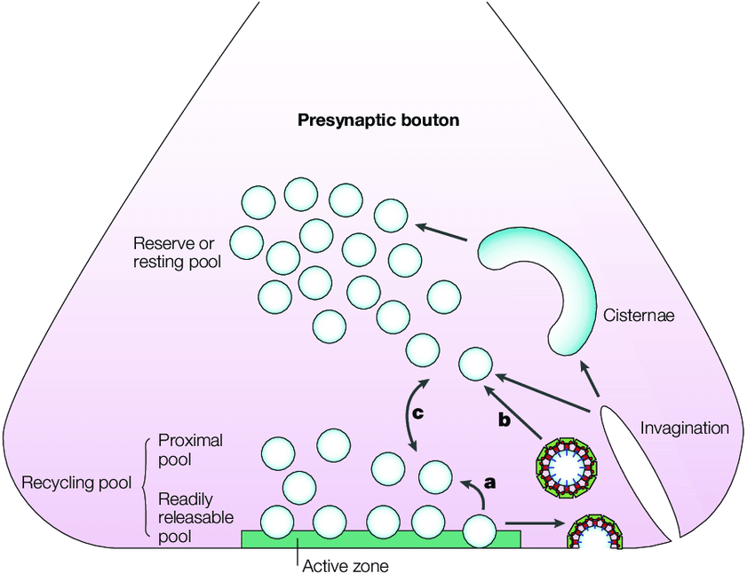
Subcellular/Oraganelle level
Example: Modeling Vesicular Dynamics
https://www.researchgate.net/publication/10921383_Temporal_and_spatial_coordination_of_exocytosis_and_endocytosis/figures?lo=1

Slide 14
Modeling Molecular Pathways
Example: Modeling the molecular pathways in a
Dopaminergic cell of Substantia Nigra pars compacta

Slide 15
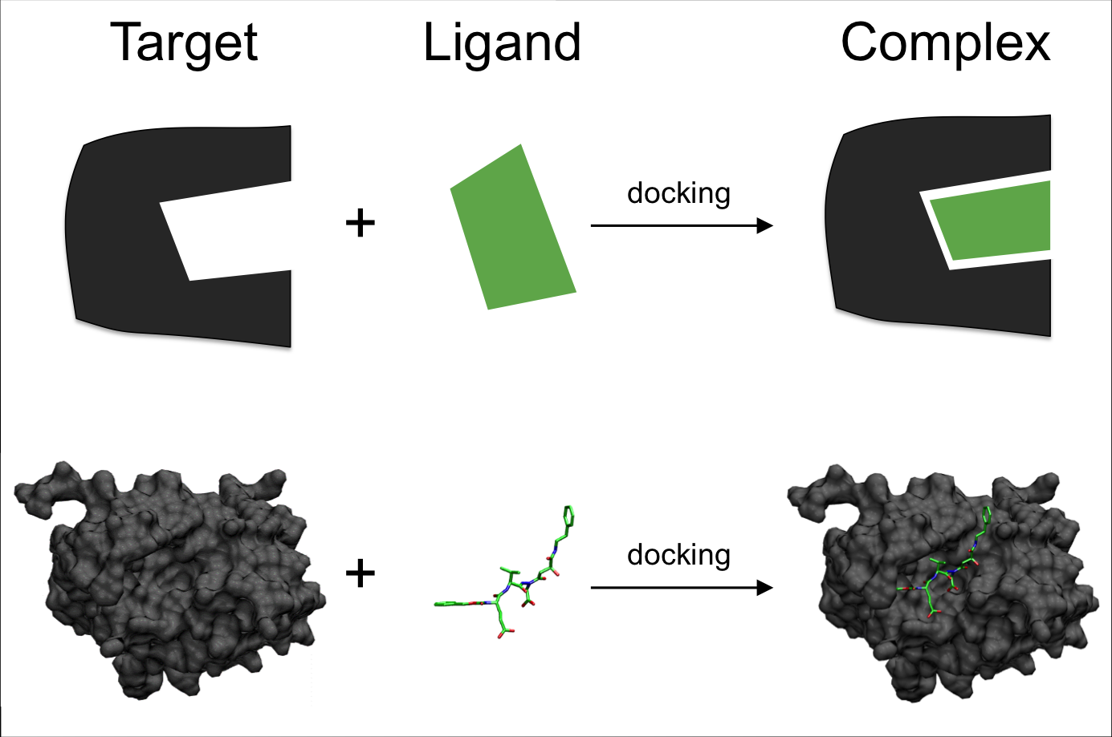
Modeling at single molecular level
Example:
Molecular Docking

